Slide 1
The Sweet Awesome App: Widget Dashboard _{Beta}
Group Lerdorf
The Three B’s

Slide 2
Presentation Setup
Select a demonstration user
set up all the user’s data
weather
stock
to-do list
news
Open firebase

Slide 3
Presentation Guide
Have one driver demonstrate the project
Open project: login and stuff
Be quick – just list and demonstrate
Then delve into details
Emphasize the functionality: add and remove widgets on demand
Brendon explains Weather
Brian explains To-do List
Brian explains Stock Ticker
Brian explains Top News
Blake explains Chat
Somebody else interacts in chat
Blake explains Gridstack

Slide 4
Step-by-step
Demonstrate Gridstack
Brian talks about To-Do List
uses firebase only, no API
demonstrate preference settings by turning of to-do widget
Brian talks about Top News
NY Times API
Widget design
Brian talks about Stock Ticker
Stock API
Pick three stocks to track
Brendon talks about Weather and jMoment
Create Kevin login.
identify Firebase authentication
Establish preferences:
turn on all widgets

Slide 5
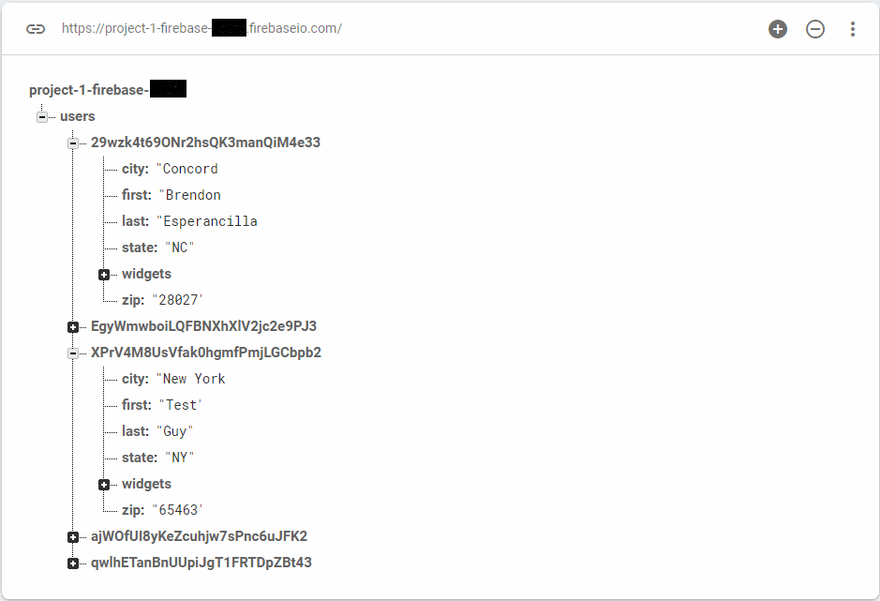
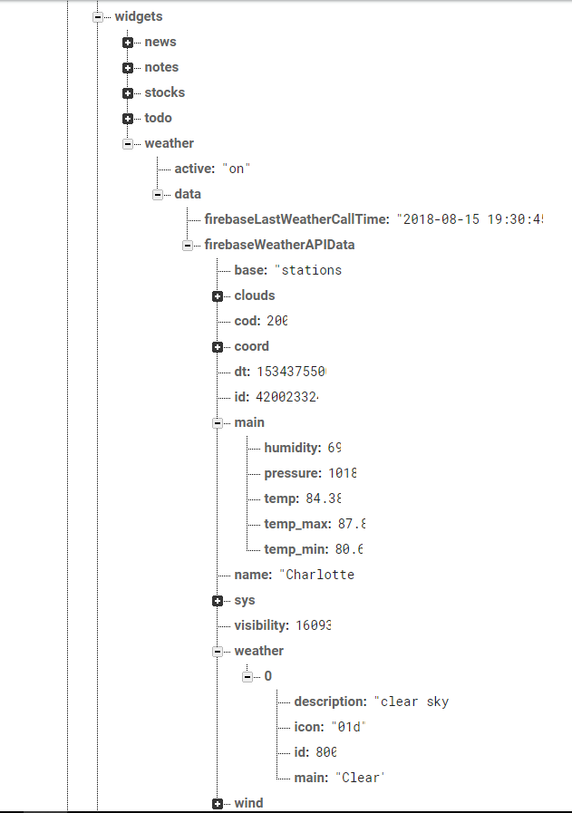
Weather
Brendon
Elaborate:
A request is sent to the API using a URL constructed based on the user’s location data.
The API data is stored in Firebase in the user child.
Challenges:
API limited to 1 call every 10 minutes.

Slide 6
To-do List
Brian
Elaborate:
Challenges:
does not appear to work on certain machines
Brendon could not get this to work

Slide 7
Stock Ticker
Brian
Elaborate:
Challenges:
navigating array of three selected stocks in Firebase

Slide 8
Top News
Brian
Elaborate:
Lists # news stories based on the selected topic.
Clicking on a story will create a window showing a
Challenges:
pop up window list wouldn’t update when a new topic is selected

Slide 9
Chat
Blake
Elaborate:
Challenges:
Would not populate with chat history on page load

Slide 10
Presentation points
Project description
Who did what
Challenges
Elaborate

Slide 11
Project overview
Dashboard of widgets
Login page
Settings page
Firebase
Gridstack library
Various APIs

Slide 12
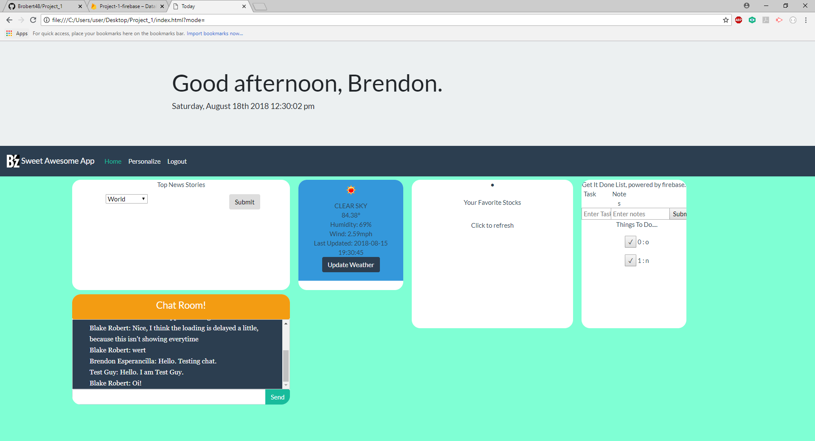
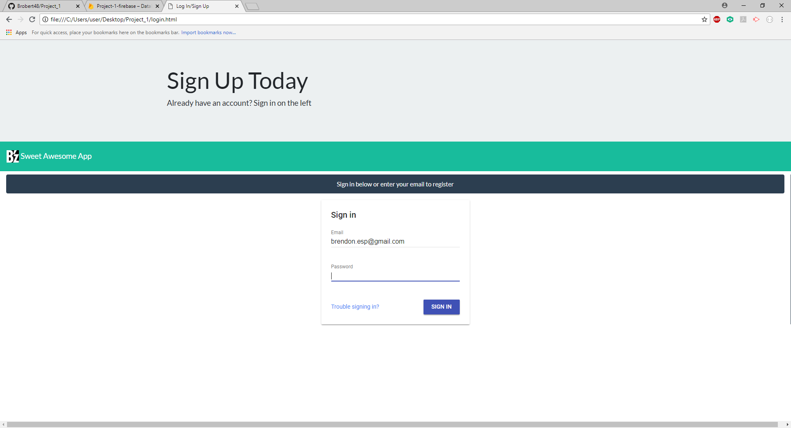
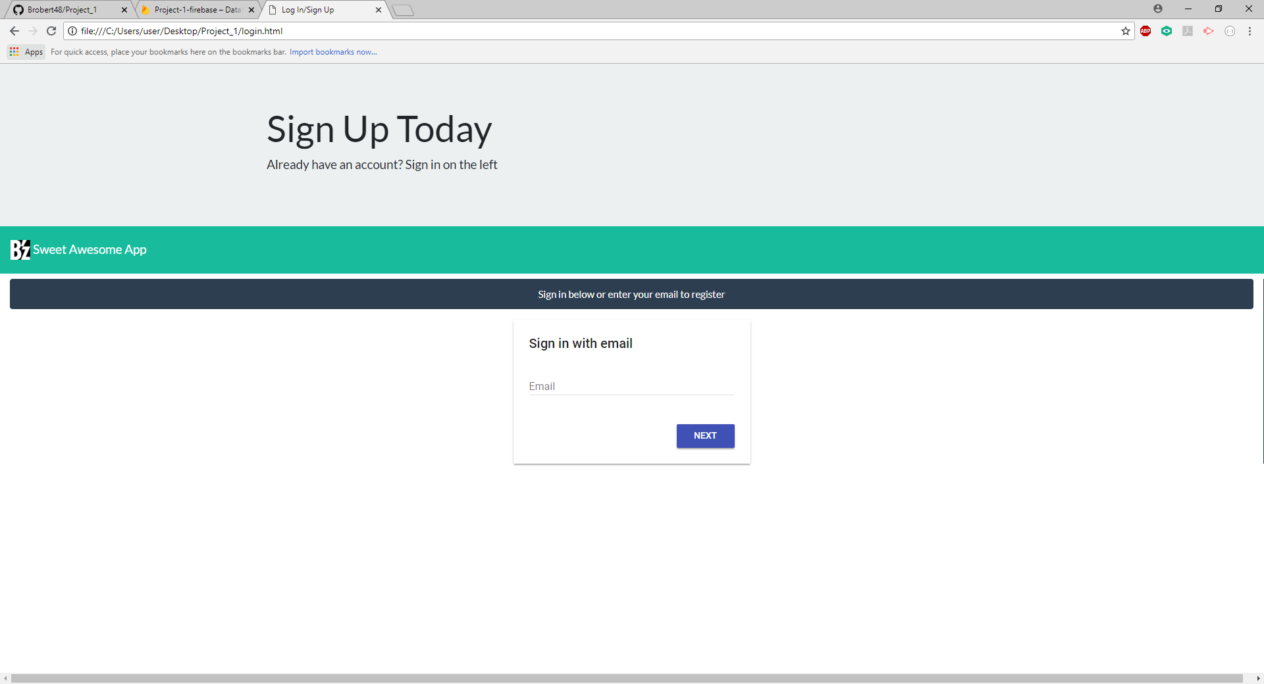
Login and Main Page
Blake
Login
Widget area
Heading
brendon.esp@gmail.com

Slide 13
Settings
Name
Location
Activate/deactivate widgets

Slide 14
Polishing the sh*t outta’ this b*tch
Blake
Elaborate:
widget populating bugfixes
Design/layout consultation:
he knows a guy
Challenges:
dynamically populating widgets interacts unfavorably with gridstack

